Slide 1
Women Safety Application
GUIDED BY,
Mr.M.Ezhilvendan M.E.,
Assistant Professor,
Department of IT.
BATCH MEMBERS :
Aravind A 420419205001
Logesh R 420419205008

Slide 2
Presentation Overview
Abstract
Problem Statement
Introduction
Literature Survey
Existing system
Proposed System
System Architecture
Modules
Module Description
Hardware and Software Requirements
Snapshots
Conclusion
Future Work
References

Slide 3
ABSTRACT
In the current situation, every woman is worried about when they will be able to walk out of home freely on the streets even at odd hours without thinking about their security things. Providing security to women in the current situation is a critical issue but very needed to every individual person. Now a day’s sexual violence against women has been increased such as rape, robbery in public transport by drivers and so on. Hence women security has become the most needable preference among many organizations. So many IT companies are looking forward to solve the security problems and thus require a framework that will work efficiently and reduce the number of crime rate. Hence this proposed project is developed to provide security for women, by sending message to nearby police station, hospital and to saved contacts. The application also sends location of the end user and also inform to the emergency contacts.

Slide 4
PROBLEM STATEMENT
At any emergency situation people get panicked and in that situation, they may not be able to operate their smartphone applications, and cannot immediately defend the attacker and protect themselves. The proposed system can be useful for women and children for security purpose. It consists of a wearable safety device having sensors and an emergency button which when activated sends an alert message with location information to the victim's family and nearby police station.

Slide 5
INTRODUCTION
In today's date, women face physical harassment in public places, schools and at workplaces or while traveling. Most cases of physical harassment take place when women are alone or while traveling. Women feel insecure to step outside their house.
There are many android applications for smartphones but for those who don't use smartphones or those who cannot keep their mobile handy at their workplace, this proposed system will be helpful. The system suggests a smart wearable device for security which contains different modules such as GSM, GPS, Button, Shock sensors.
The proposed system helps women in emergency situation by activating the modules on clicking the switch and provide emergency self-defence.

Slide 6
LITERATURE SURVEY
Women safety device and application. In this paper an ARM controller and Android application are used in which both the device and the smartphone are synchronized using Bluetooth, hence both can be triggered independently. It can record audio for further investigation and can give an alert call and message to the pre-set contacts with the instant location every 2 minutes and can be tracked live using the application.
A mobile-based women safety application (I safe Apps). In this paper, mobile-based application (I safe apps) is developed with the Android support to know whether a woman is safe. It gives the location of the woman in danger by giving fake phone calls, location and information.

Slide 7
Existing System
In the Existing System, the message will be sent to only one contact and there is no option to call the respected person and the other person also requires the application usage.
DISADVANTAGE
There is no call facility
Accept only one contact

Slide 8
PROPOSED SYSTEM
In this proposed system, the user writes the message content and also selects the contacts to which the message has to be sent and save it. So, when he is in some dangerby just opening the appand pressing the START button, the message stored will be sent to those numbers he has added in this application. So that he can receive the help in correct time.
The proposed architecture depicted below shows the exact flow of control of the android application. Here the database acts as a storing media between the two mobile devices.
ADVANTAGES
Easy to use
Call facility is included
More than one contacts can be used.

Slide 9
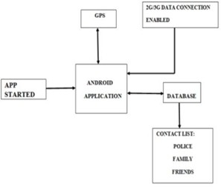
System Architecture

Slide 10
System Architecture (Contd.)
The user writes the message content and also selects the contacts to which the message has to be sent and save it. So, when he is in some dangerby just opening the appand pressing the START button, the message stored will be sent to those numbers he has added in this application.
The architecture depicted below shows the exact flow of control of the android application. Here the database acts as a storing media between the two mobile devices. The database information i.e., to which database the information has to be sent, the URL of the database is coded itself in the application. From the database, the location coordinates are sent continuously to the registered contacts of the user.

Slide 11
Modules
Module 1 :
Start Button
Module 2 :
Adding Contacts
Module 3 :
Message
Module 4 :
Stop Button

Slide 12
Module Description
START BUTTON
Which is useful for the user when he is in some problem needs any help? When the user opens this application, he can see a HELP button. Then send SMS to Register contact nos.
ADDING CONTACTS
Using this module Adding 3 Emergency contacts numbers save it. Adding Contacts can be chosen under mobile Contacts.
MESSAGE
Store some message, to your danger situation. It’s using for to send Emergency situation.
STOP BUTTON
Which is useful for the user when he is in some problem needs any help? When the user opens this application, he can see a STOP button. Then send SMS to Register contact nos.

Slide 13
Hardware and Software Requirement
Hardware Requirement
1.Laptop or PC
I3 processor system or higher.
4 GB RAM or higher.
100 GB ROM or higher.
2.Android Phone (6.0 and above)
Software Requirement
1.Laptop or PC
Windows 7 or higher.
Android Studio.

Slide 14
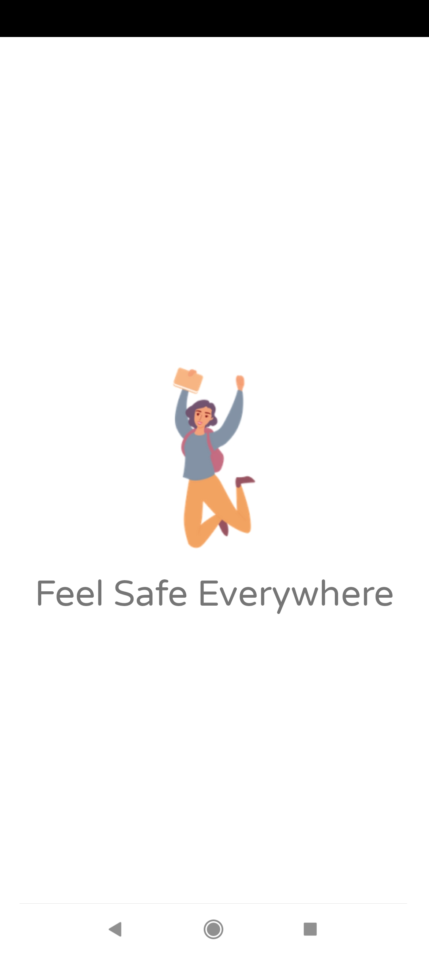
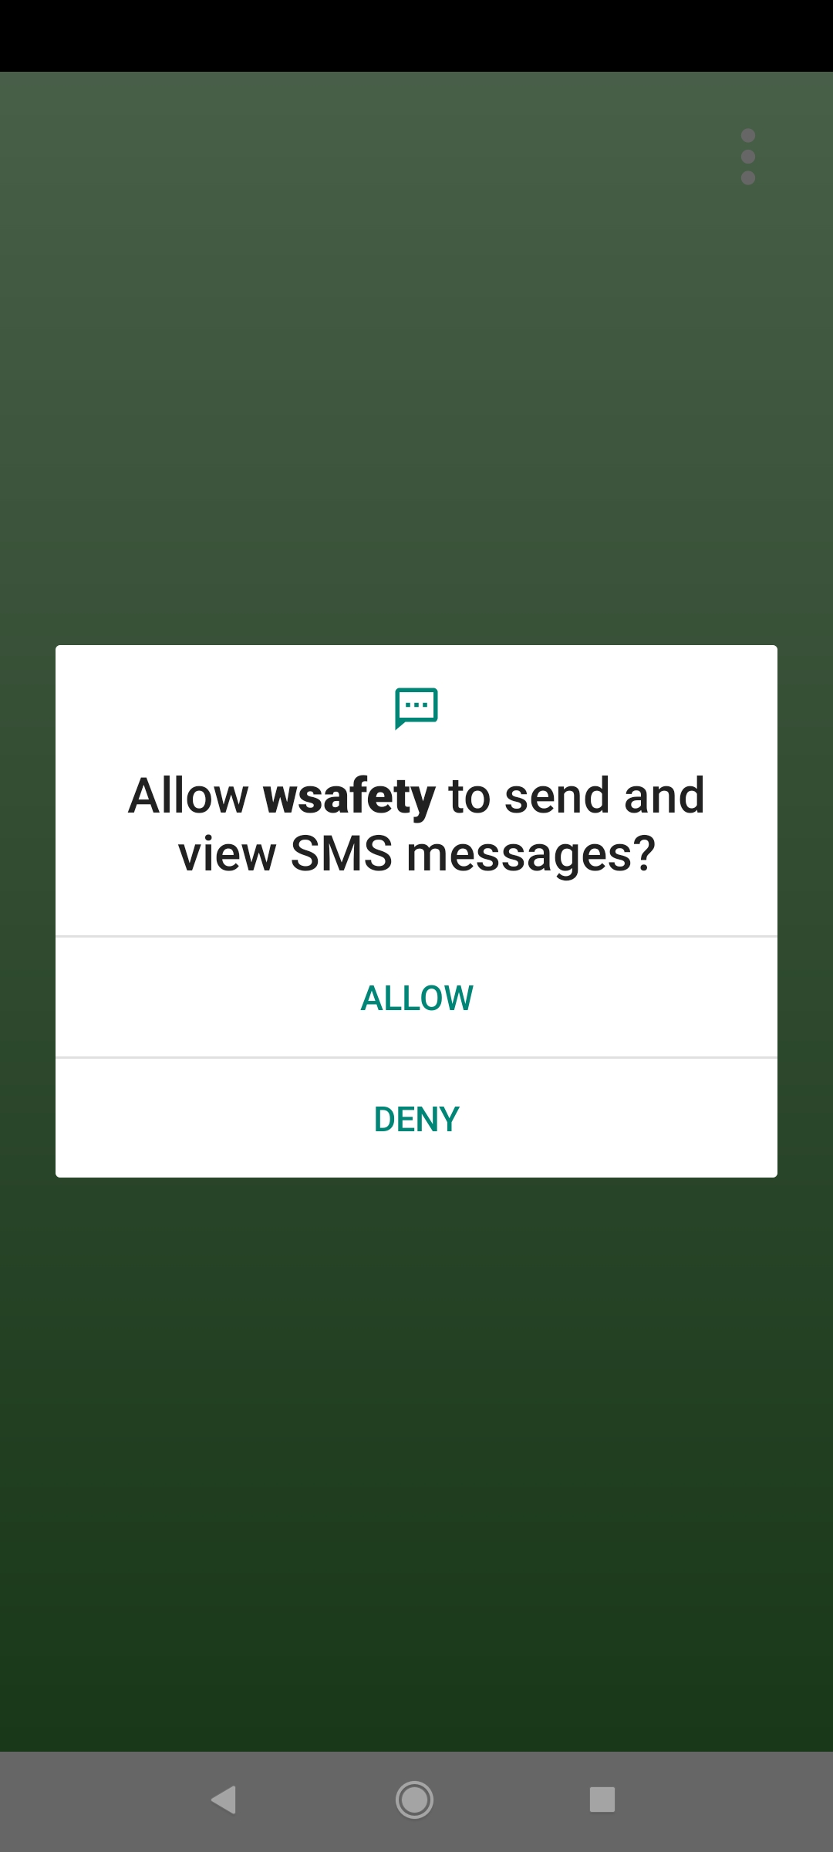
Snapshots

Slide 15
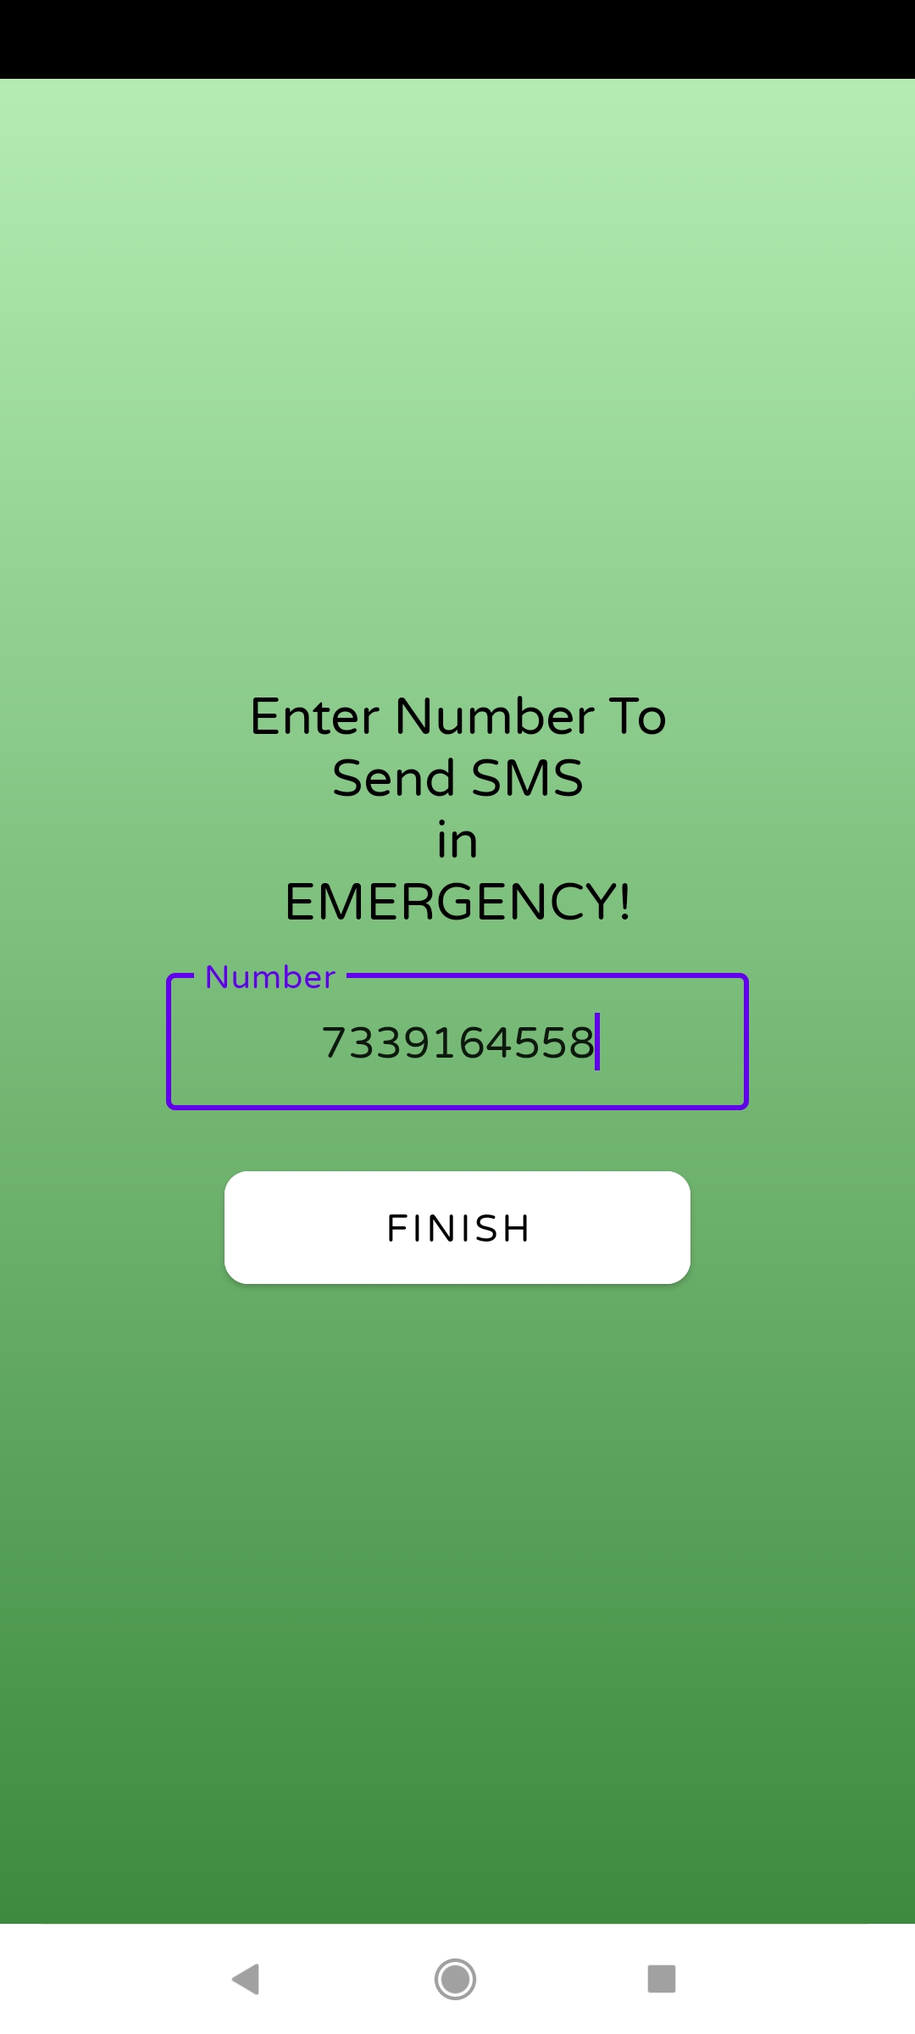
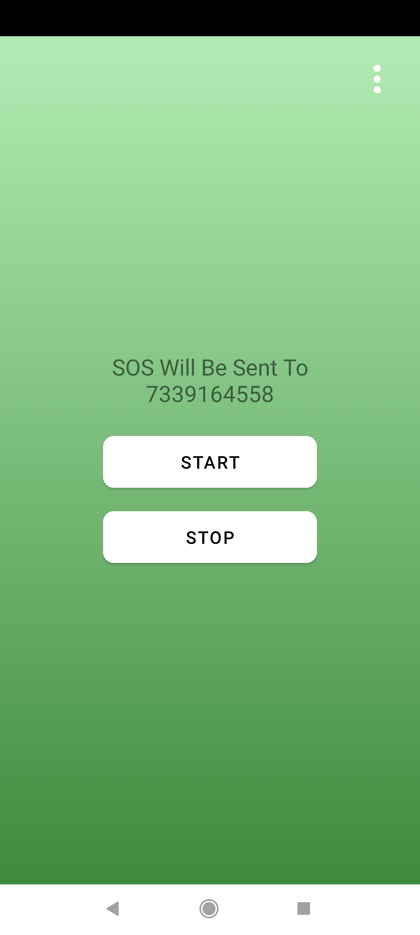
Snapshots (Contd.)

Slide 16
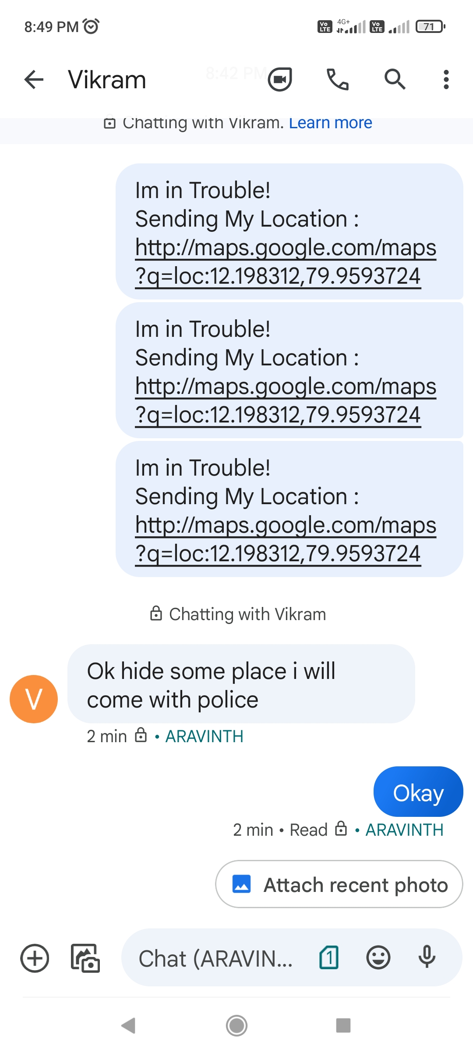

Slide 17
Conclusion
This paper describes the application, Security Alert that is designed in android platform for safety of women with the aid of recent improvements inmobile technology. In this project to use which is useful for the user when he is in some problem or needs any help. When the user opens this application, he can see a START button. Also, he can store a message and 3 contact numbers. When the user is in some difficulty or needs any help button. So, when the user opens this application can see START button.

Slide 18
Future Work
This mobile application is helpful in future when any problem arises in travelling or any kind of scenario. As the technology grows, it is possible to upgrade the system it could be adaptable to desired environment. Because it is based on object-oriented design, any further changes can be easily upgradable. Based on the future safety issues, security can be improved using emerging technologies

Slide 19
Reference
Android Developers, Location APIs. URL: http://developer.android.com/google/playservices/locat ion.html
"WOMEN’SSECURITY", AndroidApp developed by App Soft India, December 17,2013. https://play. google. com/store /apps/ details?id=com. Zayaninfotech. security&hl=en
" POLIE NEARBY", Android app developed by Big Systems in 2013. https:// play. google. com/ store/apps/details?id=com.smoketech.PoliceNearby&hl=en
" SCREAM ALARM", Android app developed by GoPalAppMakerinNovember,2013https://play. google.com/store/apps/details?id=gopal.appmaker. android. com&hl

Slide 20
THANK YOU

